Slide 1

Hair dry styling
Shawna Tuli (shawna.tuli@avanade.com)
Northern California Wellness

Slide 2
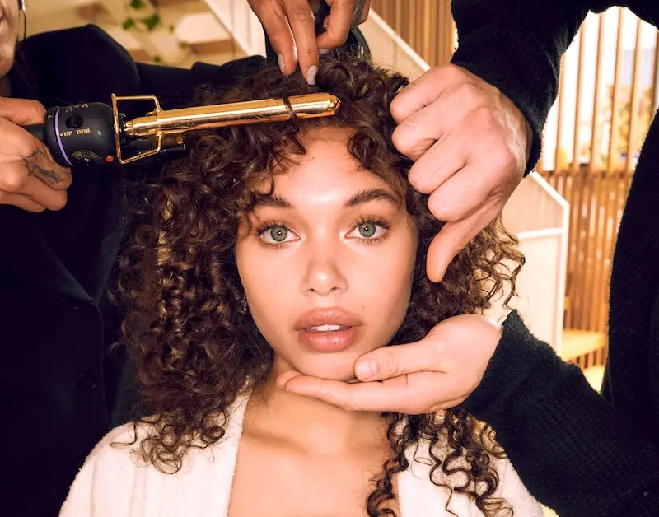

Glamsquad

Slide 3
